Slide 1

Learning Curve to Implementing a Just Culture
Building Trust and Accountability in Organizations

Slide 2

Introduction to Just Culture
A Just Culture refers to an organizational culture that emphasizes fairness, accountability, and learning in the context of managing human errors, incidents, and risks. It seeks to balance the need for accountability for actions with a recognition that errors often result from systemic issues rather than solely individual failures.

Slide 3
Key Principles of Just Culture
Transparency: Open communication about incidents and their causes.
Accountability: Holding individuals accountable for their actions based on their intentions and behaviors.
Learning: Using incidents as opportunities for learning and improvement.

Slide 4
Challenges
Resistance to Change: Cultural shift required to move from blame-oriented to learning-oriented approaches.
Complexity: Balancing accountability with fairness and avoiding unintended consequences.
Leadership Buy-in: Securing support from leadership to drive cultural transformation.

Slide 5
Steps to Implementation
Assess Current Culture: Evaluate existing practices and attitudes towards errors and accountability.
Training and Education: Educate employees on the principles of Just Culture and their role in its implementation.
Policy Development: Establish clear policies and procedures for incident reporting, investigation, and resolution.

Slide 6


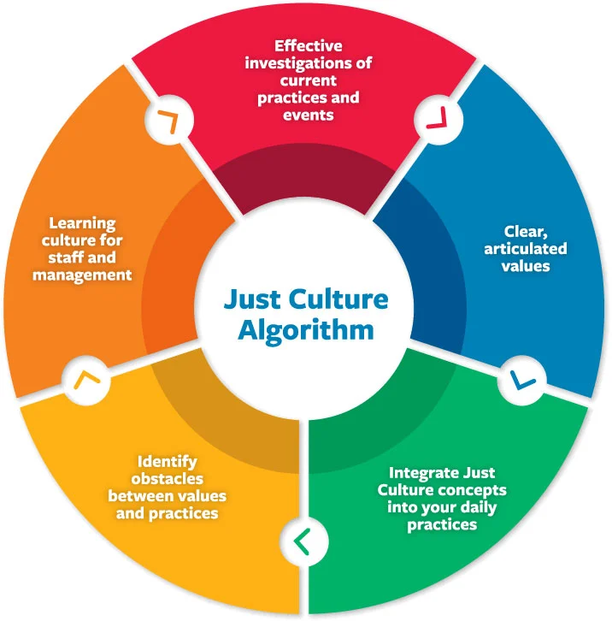

Just culture algorithm
The definition of a Just Culture focuses on three responsibilities for behavioral choices that are closely aligned with emergency medical services (EMS) care principles: the duty to act, the duty to follow a procedural rule, and the duty to avoid causing unjustifiable risk

